Slide 1
FINAl PRESENTATION:
WIRELESS V2I COMMUNICATION
PROTOCOLS FOR DRIVER ASSISTANCE
INCLUDES: BLOCK DIAGRAM & FLOWCHART, CURRENT STATUS, CURRENT CHALLENGES
BY: CONOR POWER, DANIEL COLLINS., SCOUT CASE, JAMES TOMPKINS

Slide 2

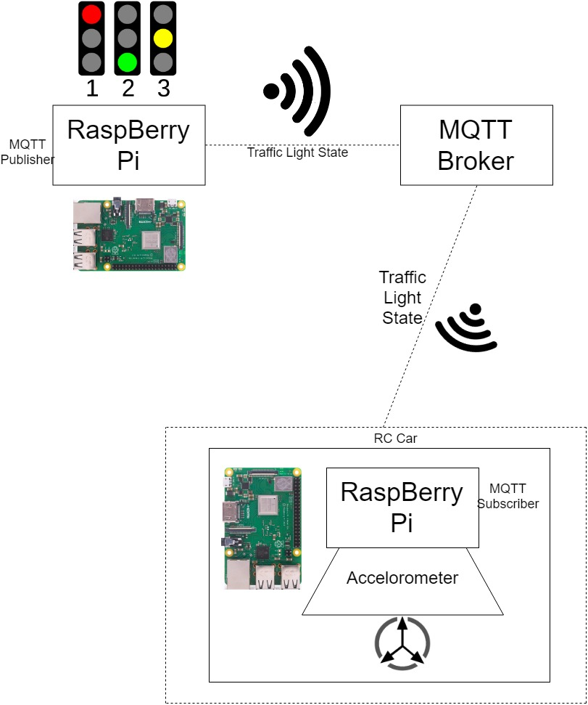
BLOCK DIAGRAM:
The Raspberry Pi exports state
The Raspberry Pi car is constantly searching for new data
Both Raspberry Pi’s are connected to MQTT broker and receive next decision data from it

Slide 3
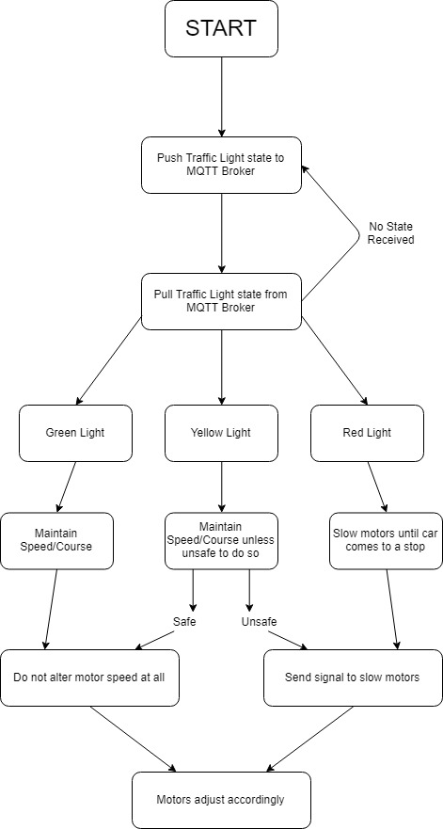
FLOW CHART
Raspberry Pi Car constantly looks for MQTT
When connected, the Pi receives traffic light state
Raspberry Pi car decides next action based on traffic light state

Slide 4
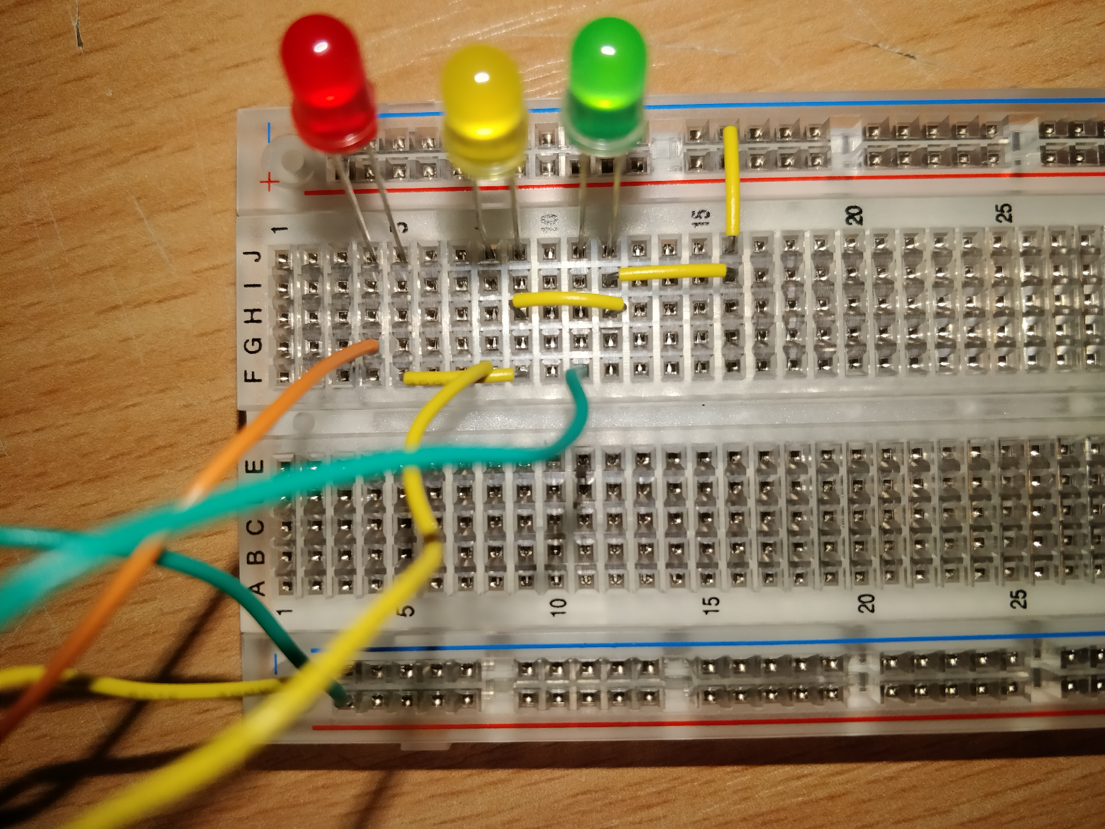
CURRENT STATUS OF PROJECT
Traffic light state system completed
Code alterations to python
MQTT broker

Slide 5

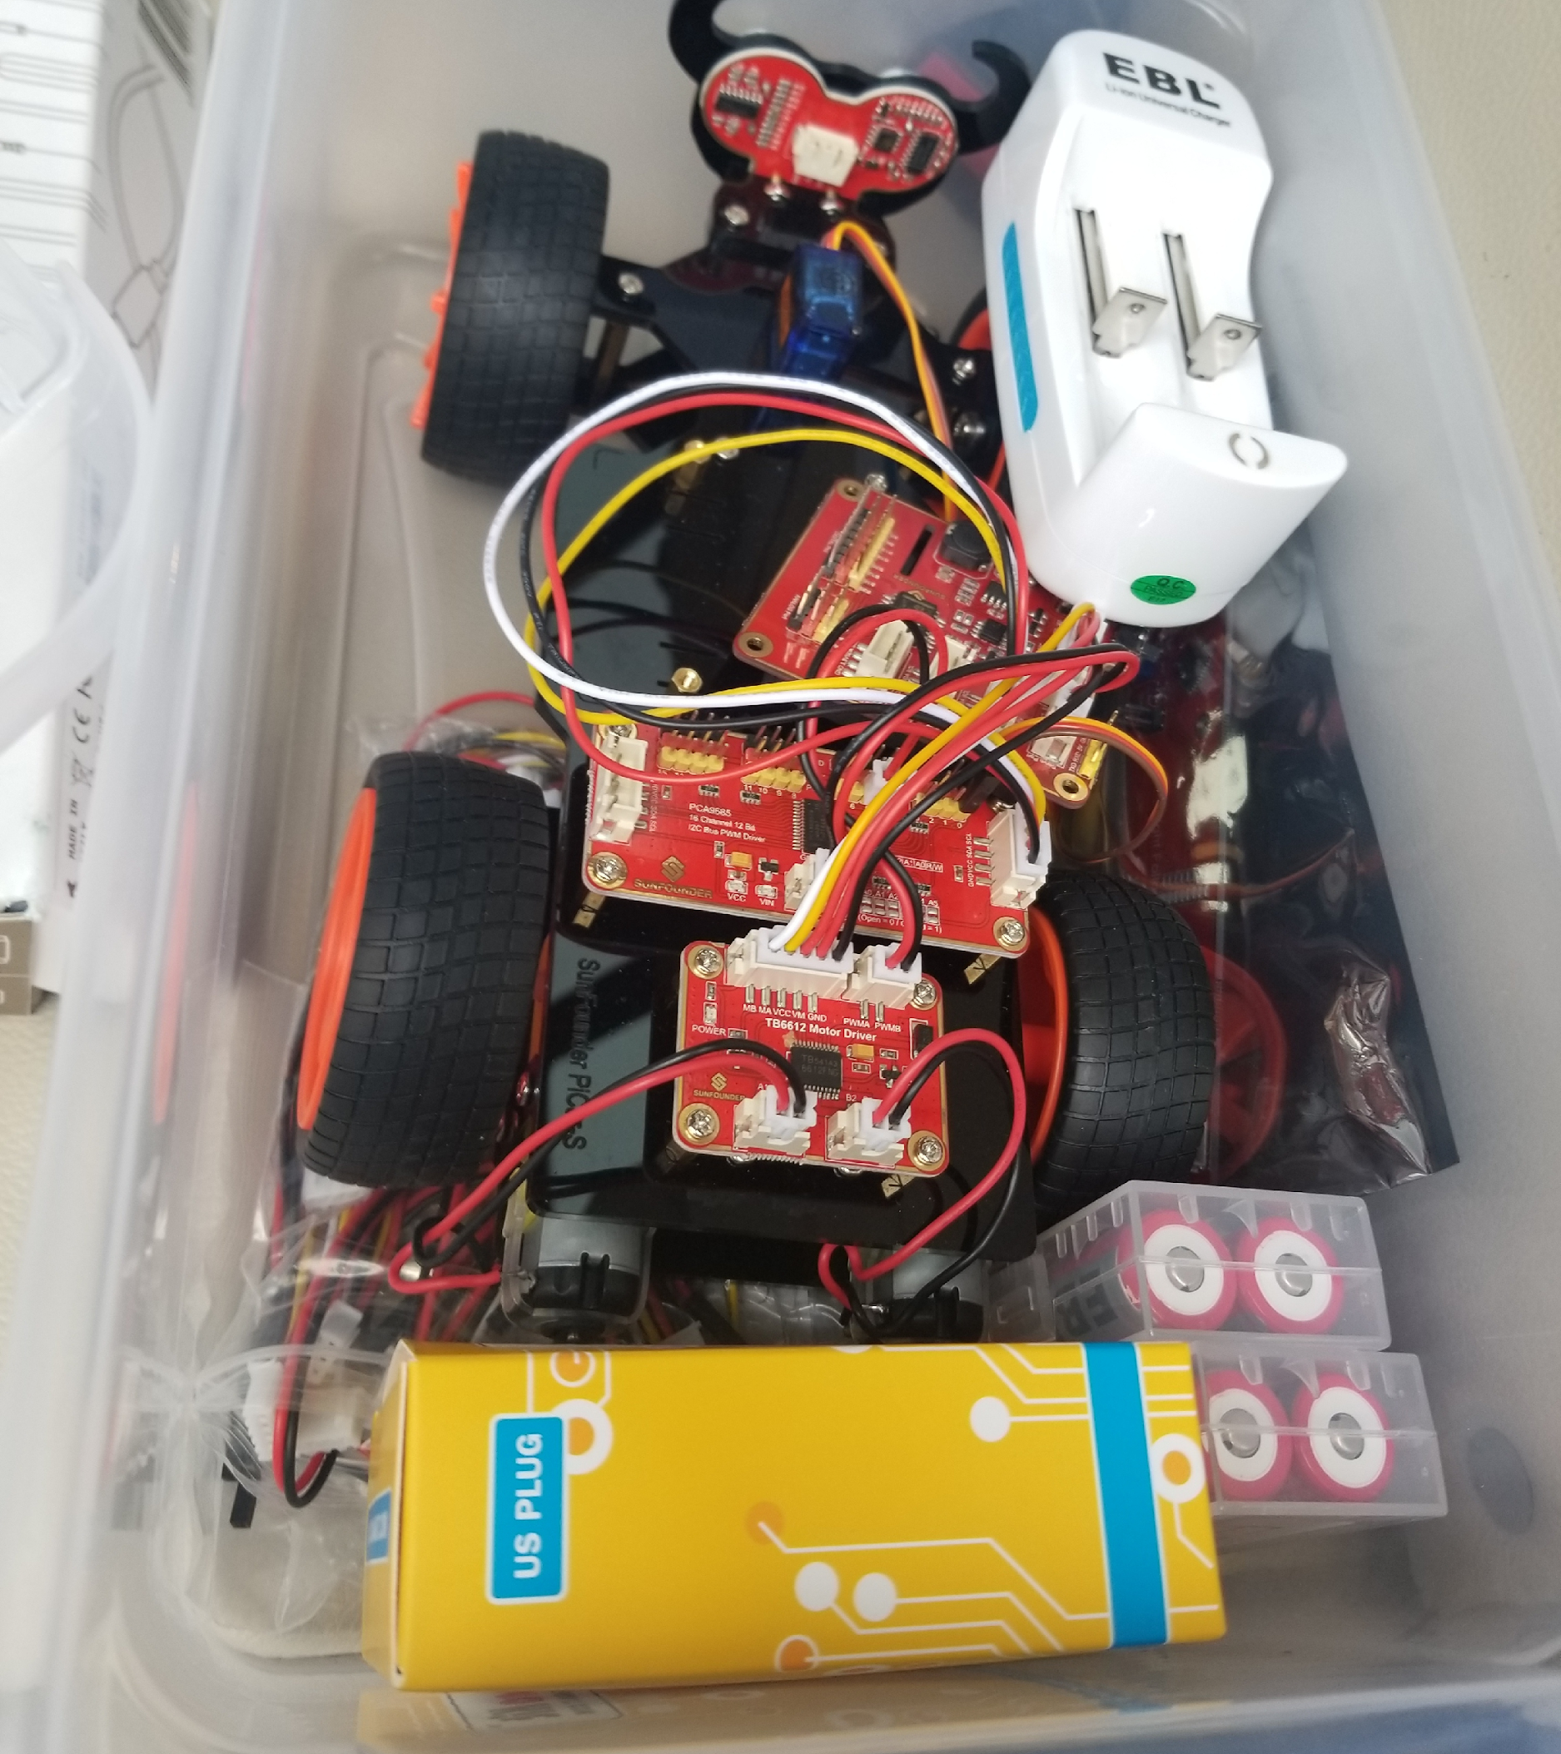
CURRENT STATUS OF PROJECT
Constructed Raspberry Pi Car
Accelerometers and GPS sensor Installation
Building code for traffic light sensor retrieval

Slide 6
PROBLEM STATEMENT/ CURRENT CHALLENGES
Hosting the traffic light state on the MQTT Broker.
Altering code from C++ to python
Retrieving a MQTT Broker from ‘www.cloudmqtt.com’
Program to run the Pi car using different traffic light states

Slide 7
RATIONALE
Determining our connection standard we would like to use
MQTT publishers and subscribers more practical
Faster connection and data retrieval
Notes:
Originally, we had planned on using Bluetooth Low Energy beacons to retrieve the traffic light status from a HTTP Web Page. However, from doing last weeks lab on MQTT Publishers and Subscribers, we have decided this would be a more logical and practical way of parsing the state of the traffic lights. The MQTT approach should also be faster to connect to and retrieve the data than the BLE approach.

Slide 8


